Slide 1

SPA
MANAGEMENT
SYSTEM
May 2024
By:
Saroj Baral,
Srenka Bhandari,
Sabin Pandey,
Anish Poudel

Slide 2

INTRODUCTION
The SPA Management System is:-
Desktop application to manage appointments.
Why was this idea proposed?
Feasibility of the SPA Management System.
What kind of application is it?
Where does this system mainly focus on?
How exactly is this going to help the current management of SPAs?

Slide 3

PROBLEM STATEMENTS:
Micro level
Macro level
Inconvenient for Customers due to Operational Challenges
Inconvenience due to manual recording
Lack of Convenience for Administration
Lack of Centralized Management
Lack of tech adaptation
Difficulty in competing in the market

Slide 4

OBJECTIVES
Develop a user-friendly desktop application
Enable seamless appointment scheduling
Enhance service management
Implement robust transaction tracking
Ensure administrative control and security
Optimize resource allocation and efficiency
Ensure scalability and flexibility
Conduct through testing and quality assurance
Provide comprehensive training and support

Slide 5
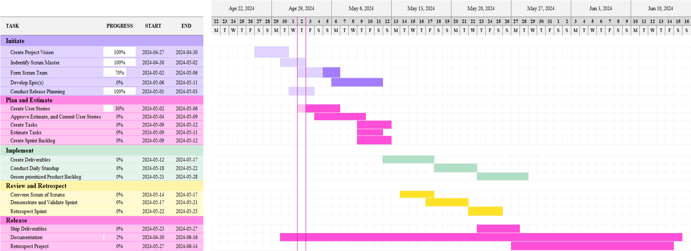
GANTT CHART
Fig: Gantt Chart

Slide 6
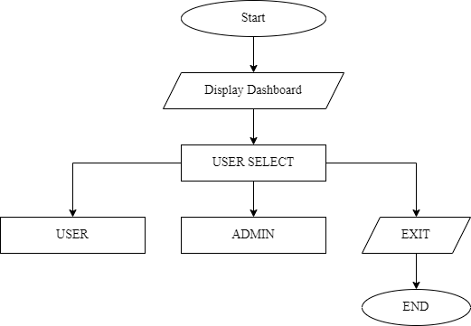
Login Panel Flowchart
Fig: Login Flowchart

Slide 7
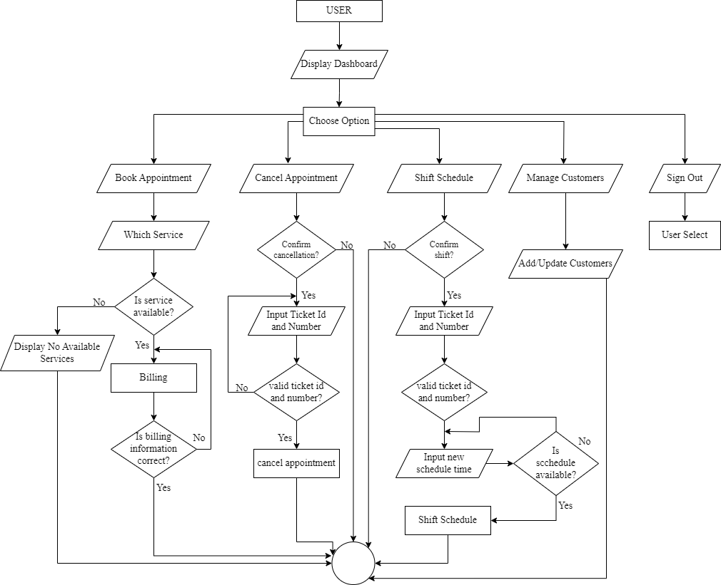
User Panel Flowchart
Fig: User Flowchart

Slide 8
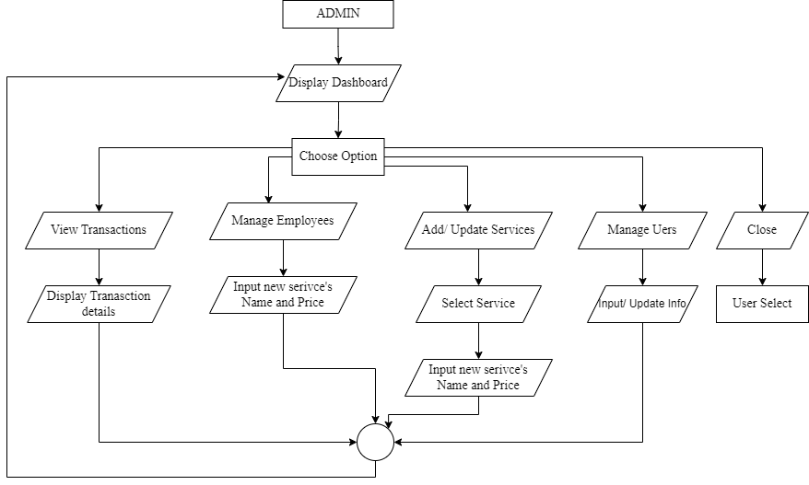
Admin Panel Flowchart
Fig: Admin Flowchart

Slide 9
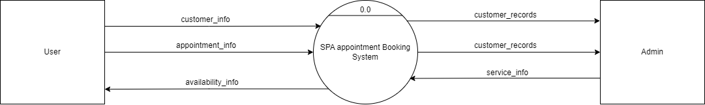
DFD 0
Fig: DFD 0

Slide 10
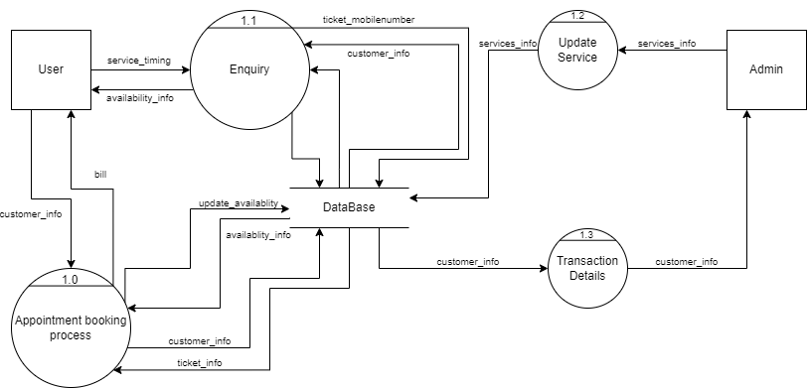
DFD 1
Fig: DFD 1

Slide 11
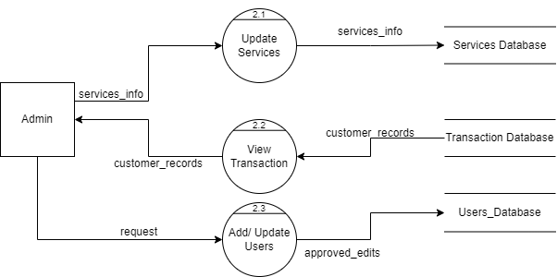
DFD 2 - ADMIN
Fig: DFD 2 - ADMIN

Slide 12
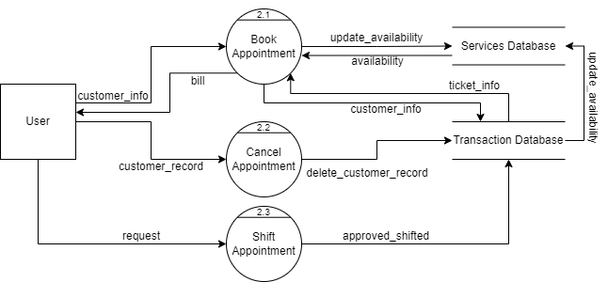
DFD 2 - USER
Fig: DFD 2 - USER

Slide 13

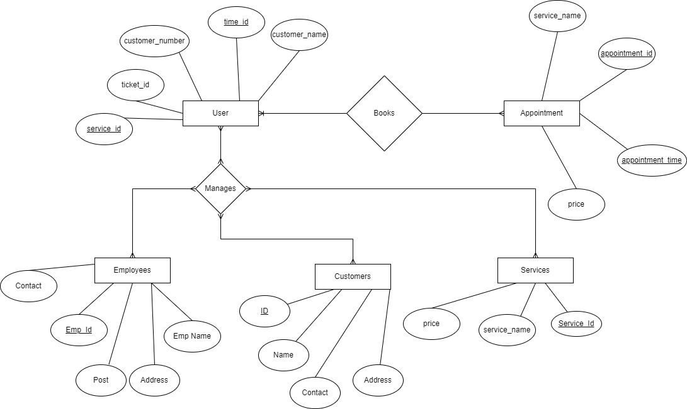
ER DIAGRAM
Fig: ER DIAGRAM

Slide 14

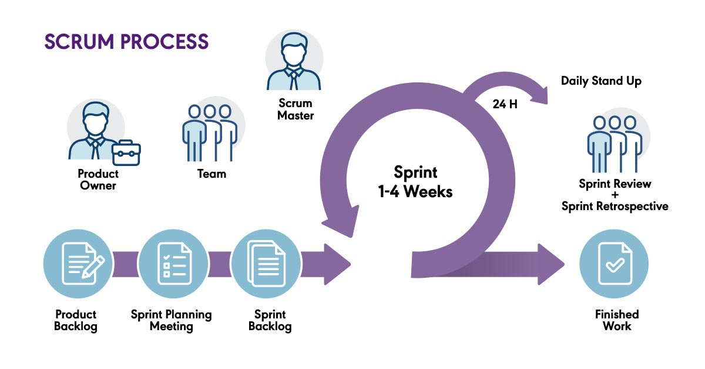
DEVELOPMENT METHODOLOY
SCRUM
Agile scrum methodology is a project management system that relies on incremental development. Each iteration consists of two- to four-week sprints, where the goal of each sprint is to build the most important features first and come out with a potentially deliverable product. More features are built into the product in subsequent sprints and are adjusted. Scrum is a lightweight framework that helps people, teams and organizations generate value through adaptive solutions for complex problems.
Fig: SCRUM METHODOLOGY

Slide 15
DELIVERABLES
Software Requirement Specification Document
Initial Prototype
Incremental Software Releases
User Documentation
Administrator Documentation
Test Cases and Test Reports
Deployment Package
Training Materials

Slide 16

Thank You

